Slide 1
Remembering our Mothers

Slide 2
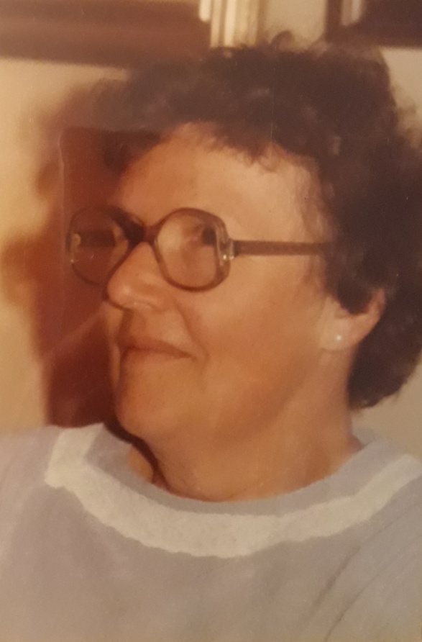
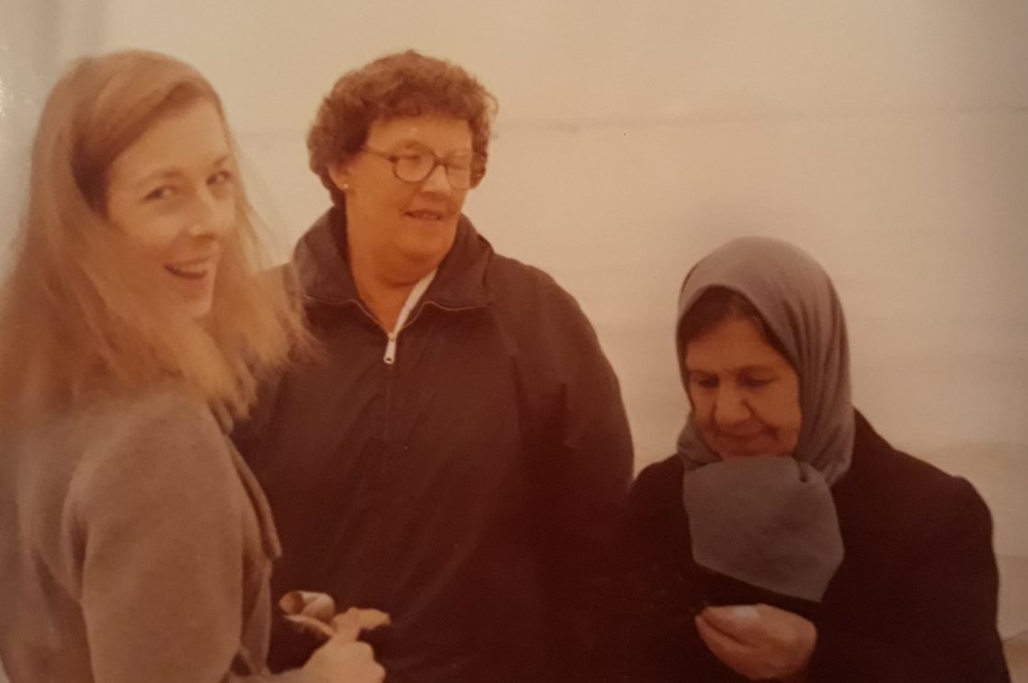
Kristina Joukhadar’s Mother and Mother-in-law
Rosemary Archtander

Slide 3
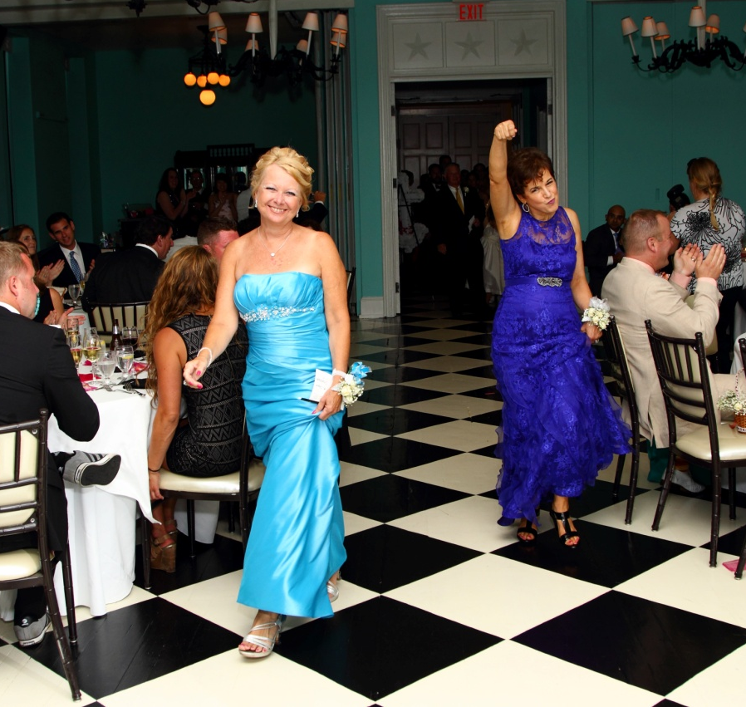
Sharon Barrett, Kelly’s Mother and Pam Campana, Larry’s Mother

Slide 4
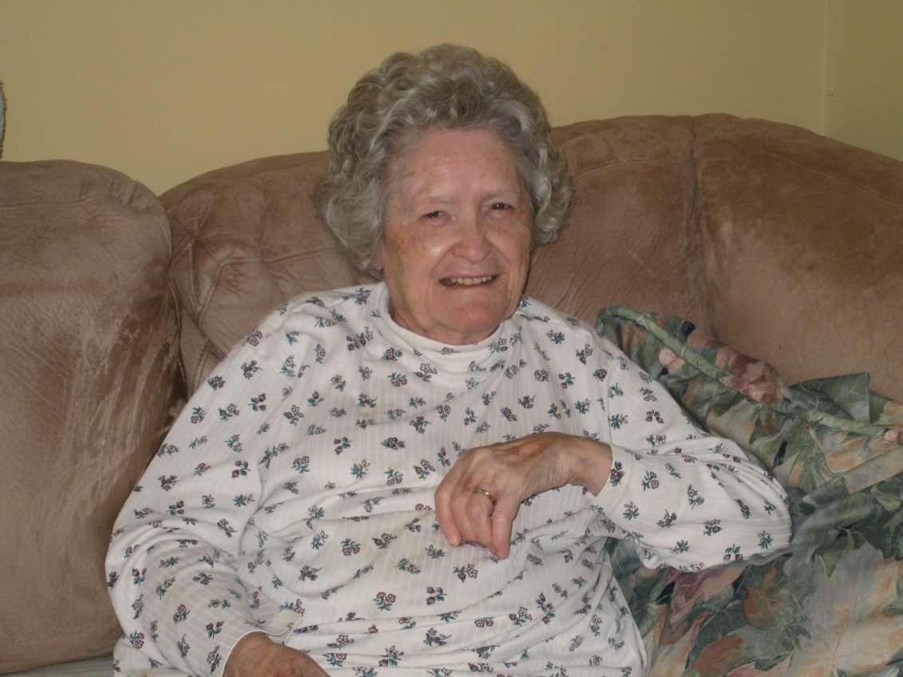
Margaret Elizabeth Beeler, Judy Vindheim’s Mother

Slide 5
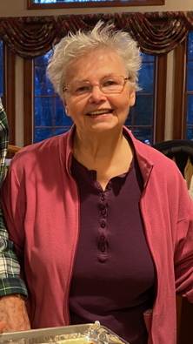
Anita Boeschen, Nancy Leppla's mom

Slide 6
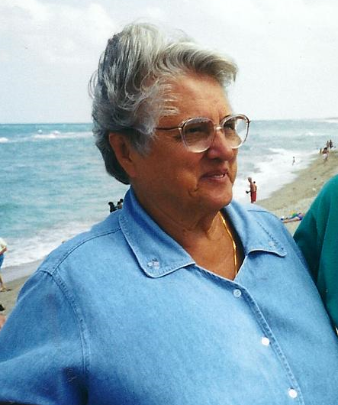
Jessica Brauns, Charlene Schindler’s Mother

Slide 7
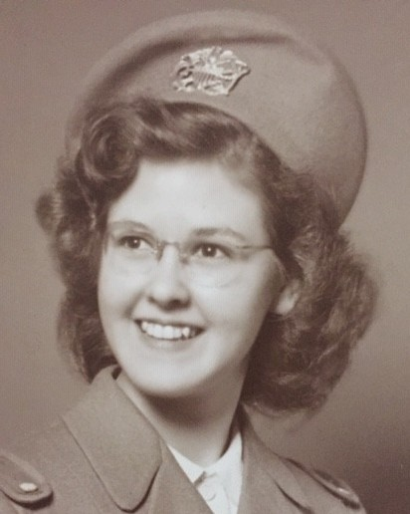
Priscilla Bromley

Slide 8
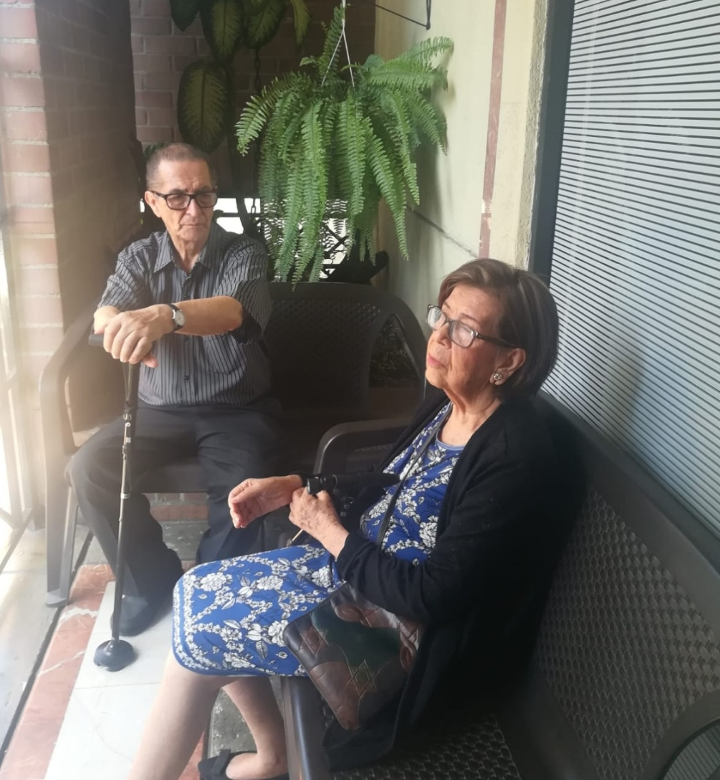
Carmen, Maria Restrepo's Mom

Slide 9
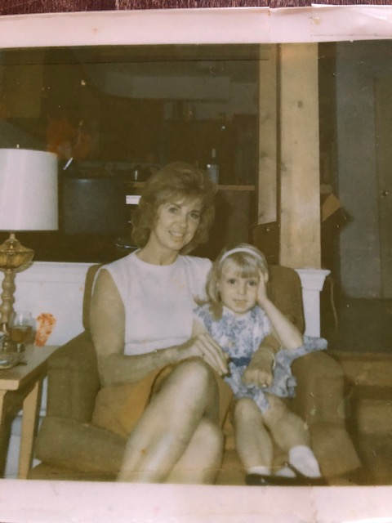
Maggie Conroy’s Mom

Slide 10
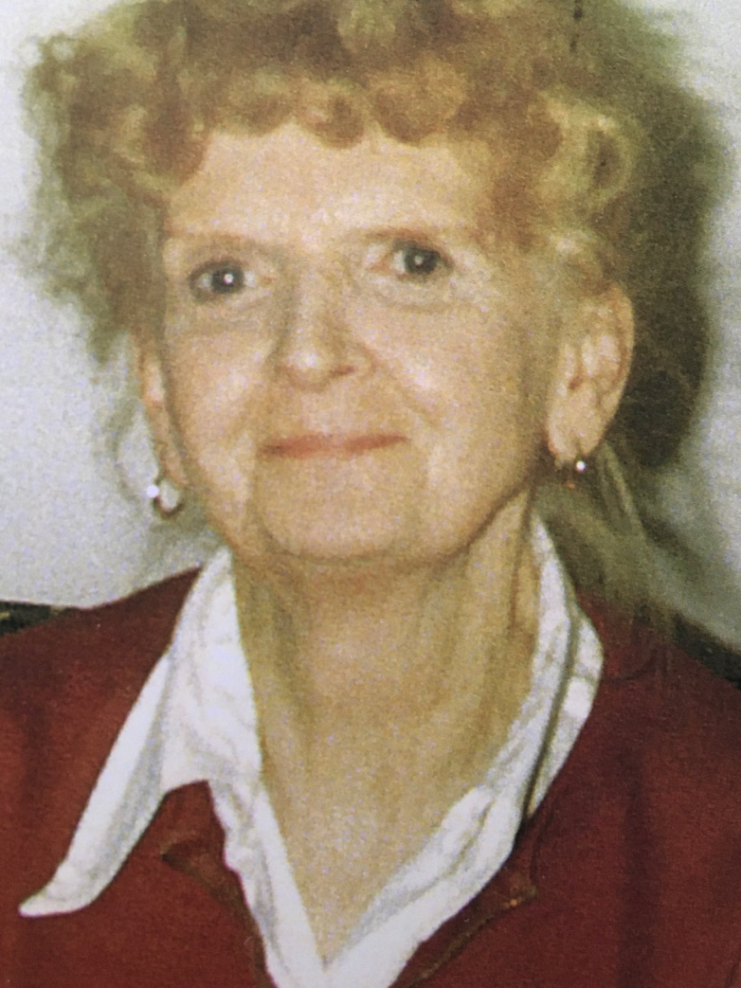
Juanita Cruse-Meyer, Marge Jenkins' Mom

Slide 11
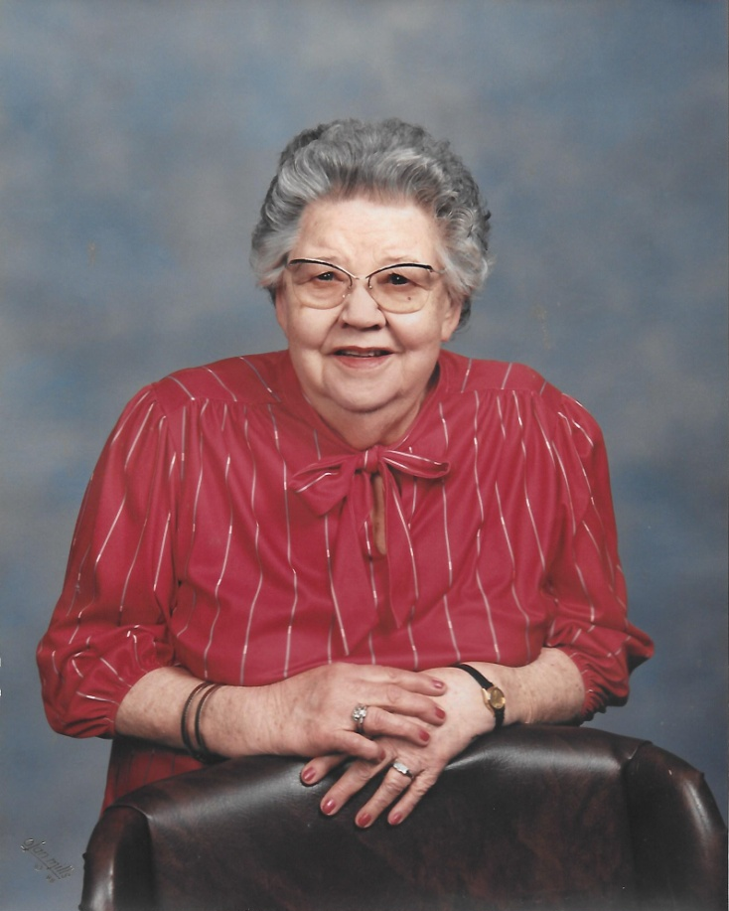
Sarah Redmond Dankel, Leah Larsen’s Mother

Slide 12
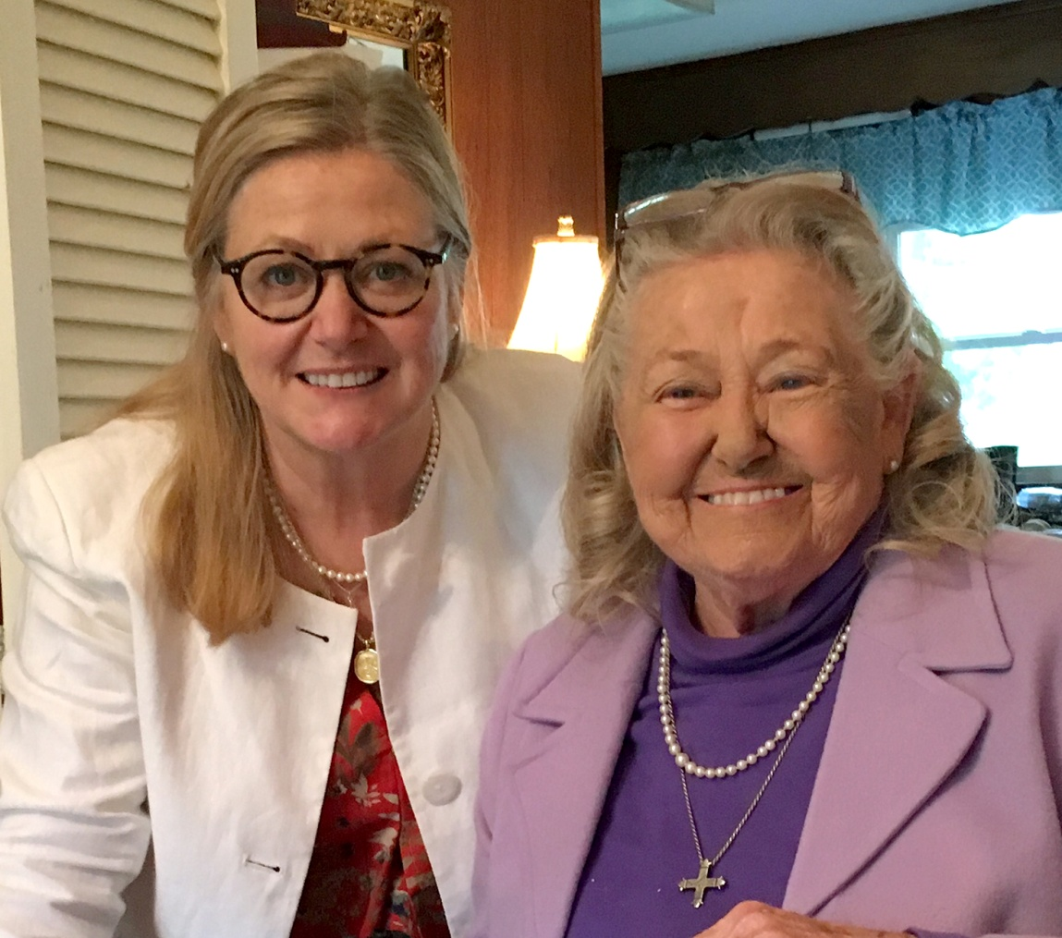
Jacqueline, Anne Ewing's Mom

Slide 13
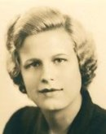
Priscilla Gminski

Slide 14
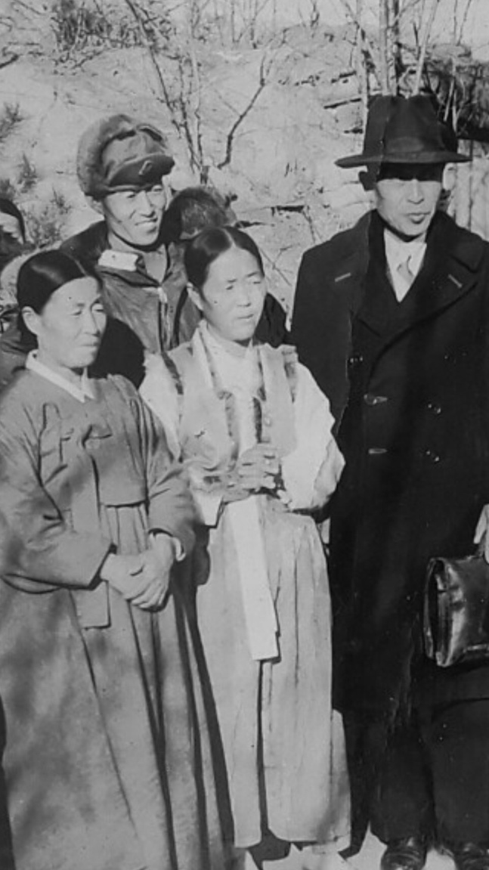
Suk Hwa Han, Young Yun Choi's Mom

Slide 15
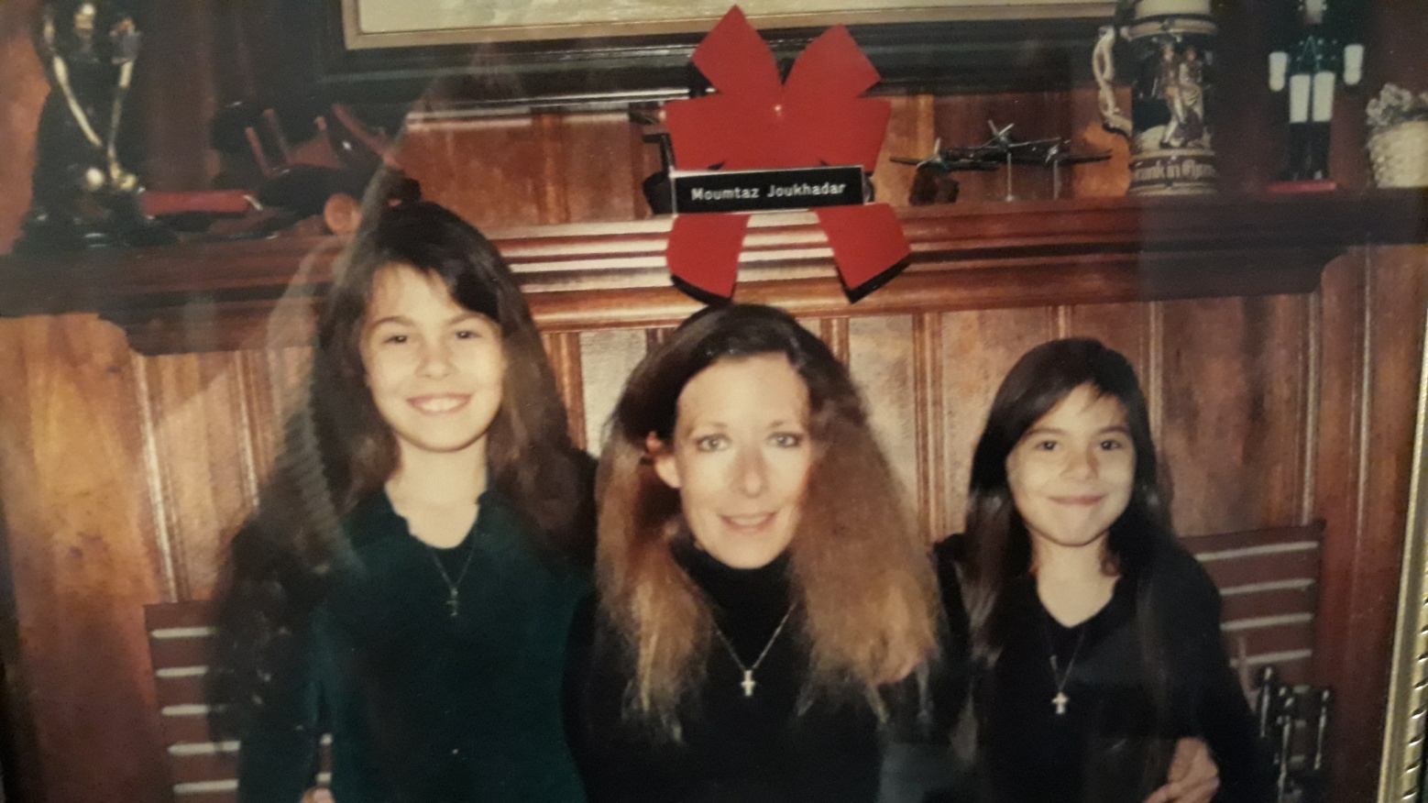
Kristina Joukhadar, Zein and Dana's Mom

Slide 16
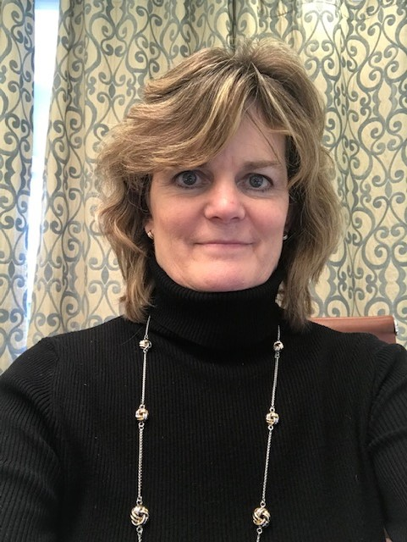
Patty Jurgielewicz, Andrew and Dana’s Mother

Slide 17
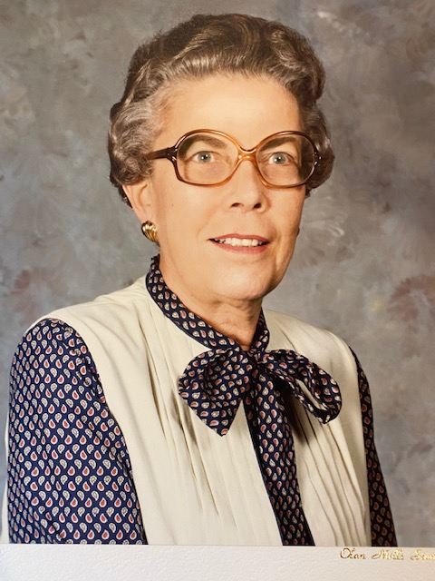
Margaret Keefe, Karen Price's Mom

Slide 18
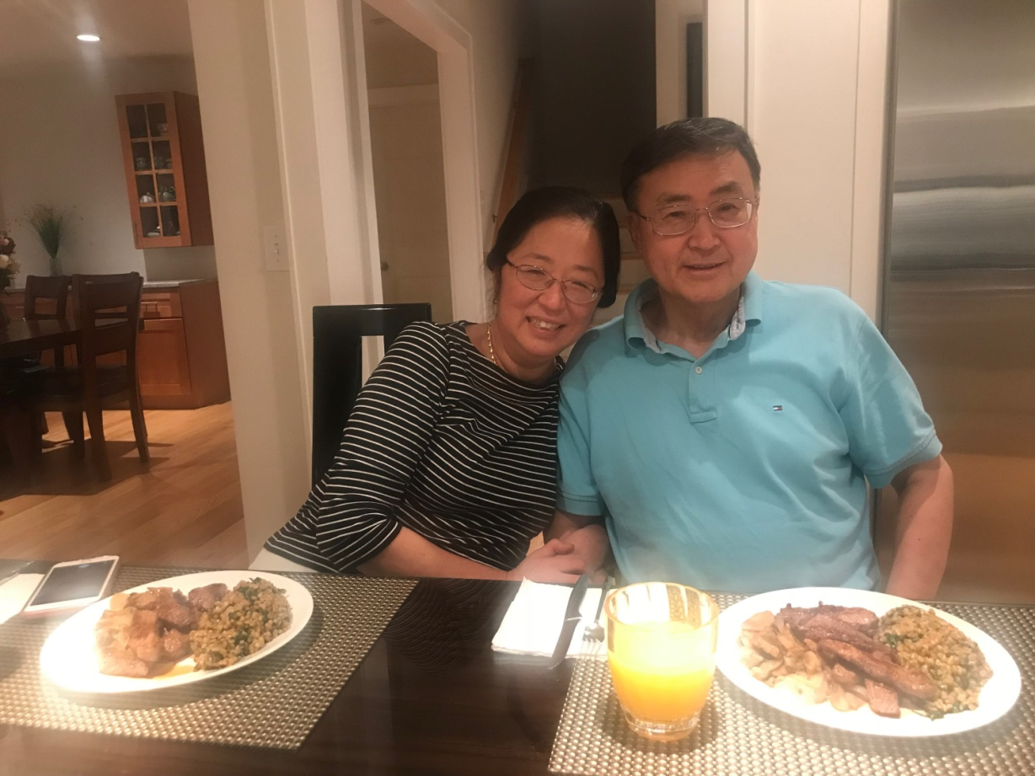
Grace Kim, Joshua's Mom

Slide 19
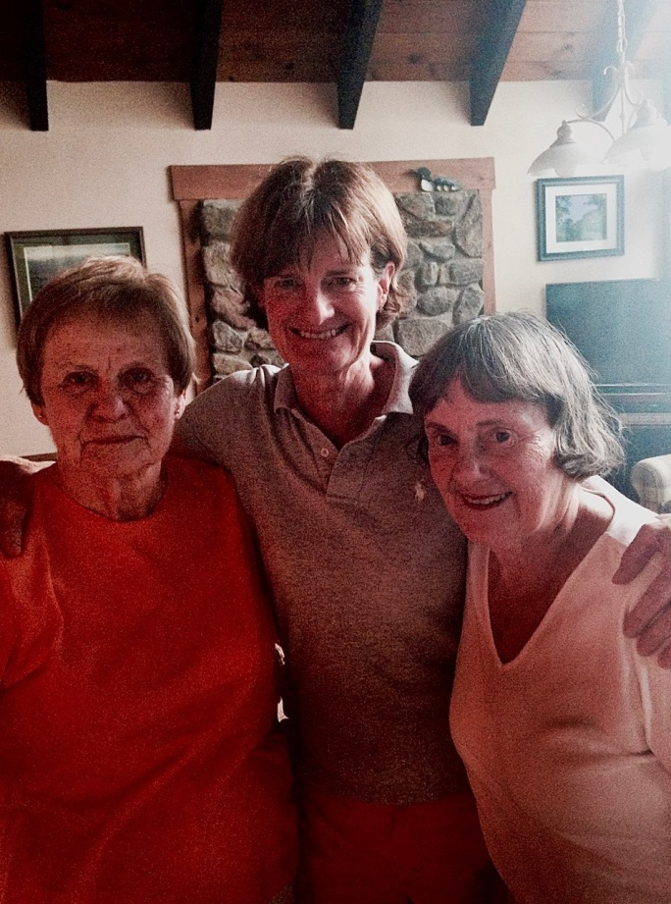
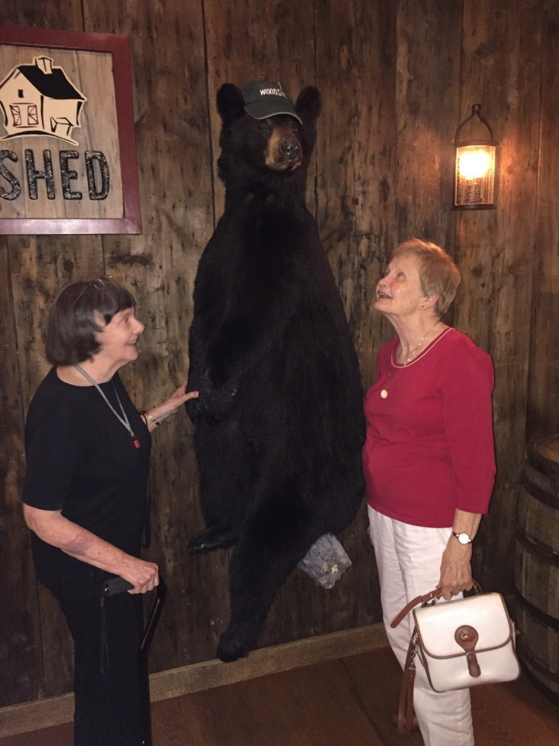
Ann Kisseberth, Ruth Bedson and Mary Bedson

Slide 20
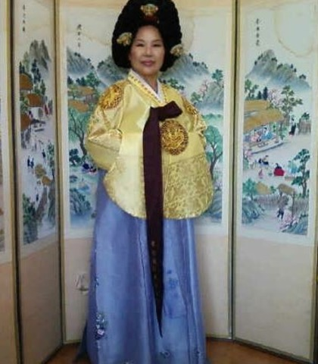
Bok Hee Loftus, Nancy Chavez’ Mom

Slide 21
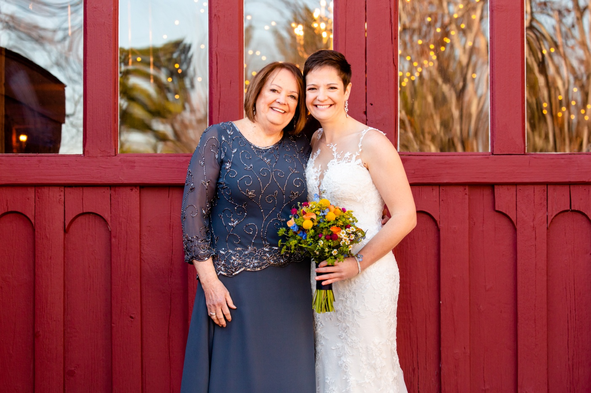
Franklyn MacLean, Taylor's Mom

Slide 22
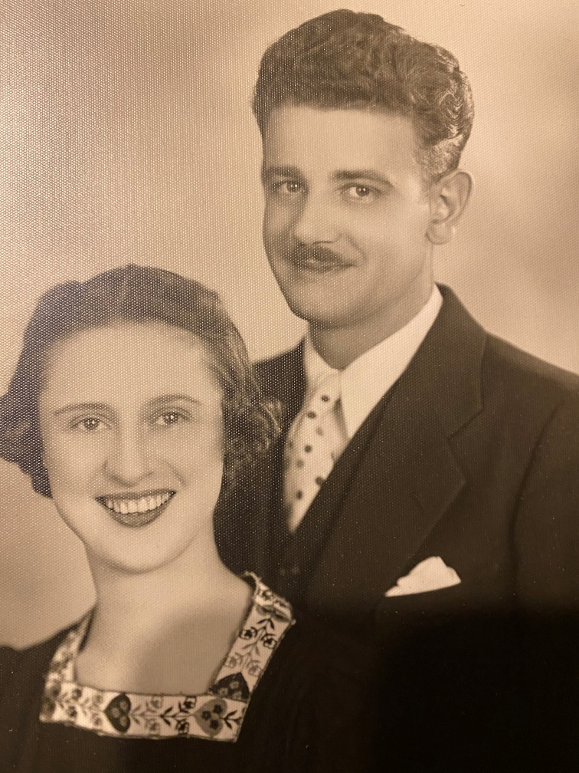
Magdalen Meyer, Paul Meyer's Mom

Slide 23
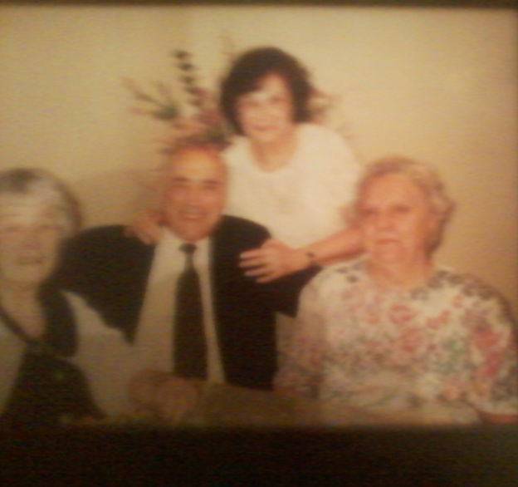
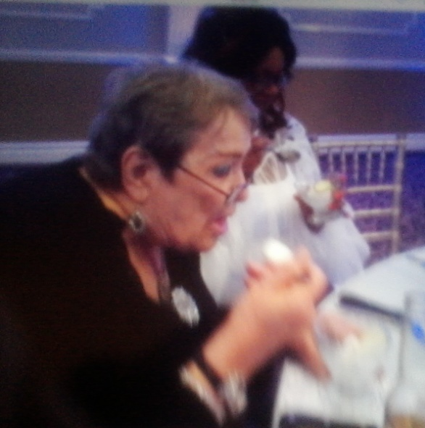
Antoinette Miller, Bill Miller's Mom Vivian, Debra Miller's Mom

Slide 24
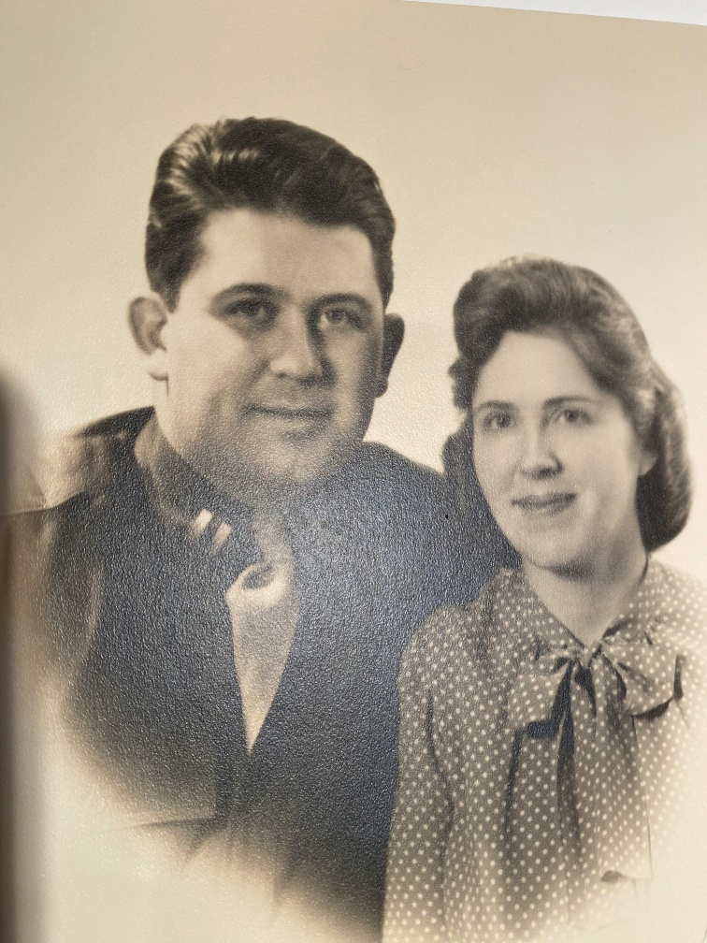
Margaret Pugh, Judy Meyer's Mom

Slide 25
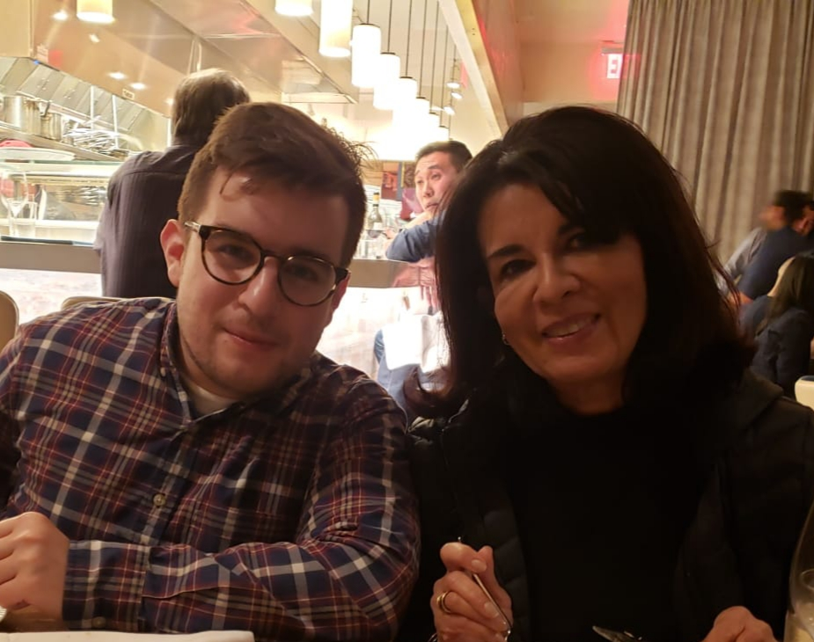
Maria Restrepo, Miguel's Mom

Slide 26
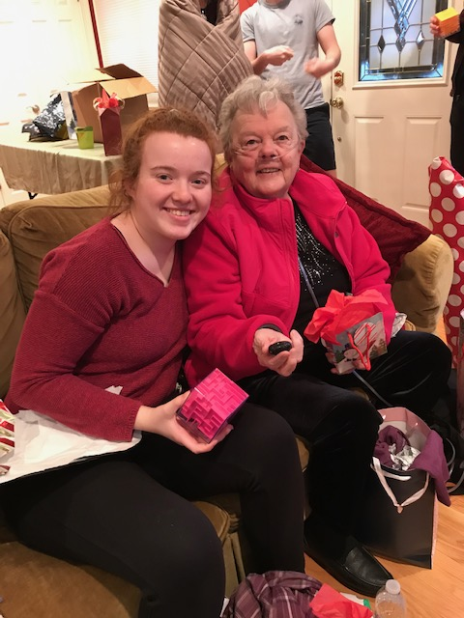
Pat Rozelle

Slide 27
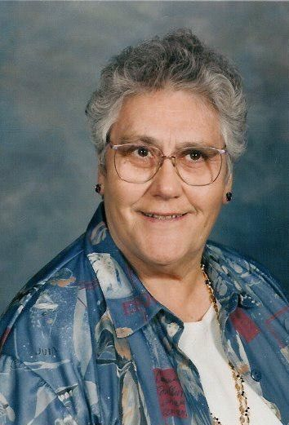
Elizabeth Savage

Slide 28
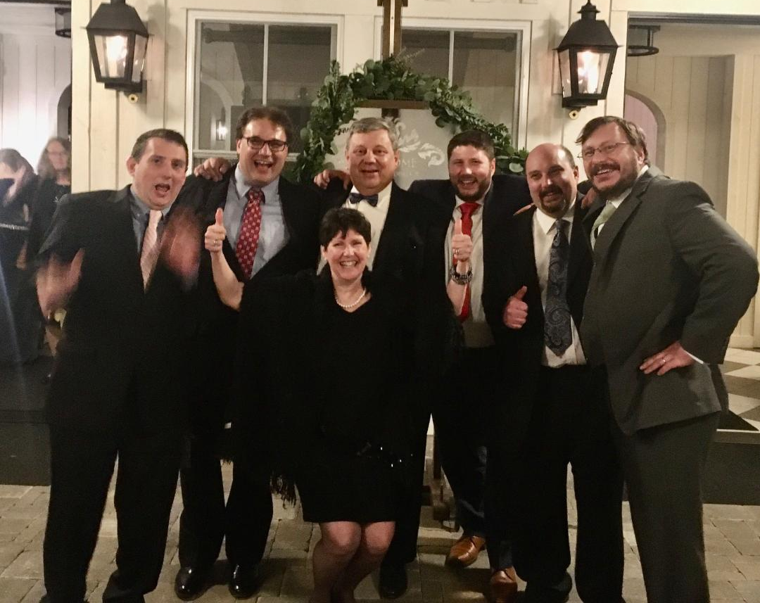
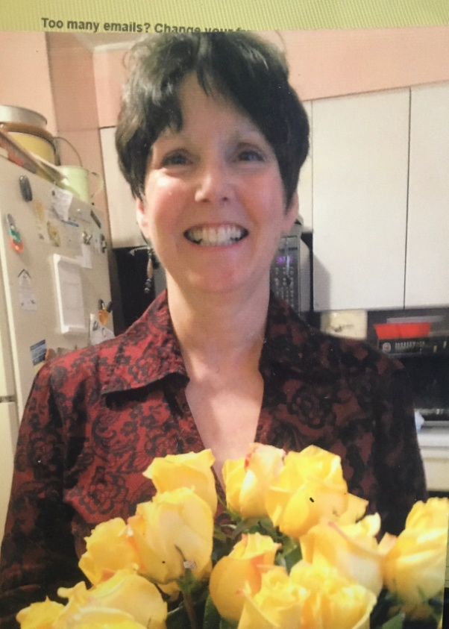
Charlene Schindler

Slide 29
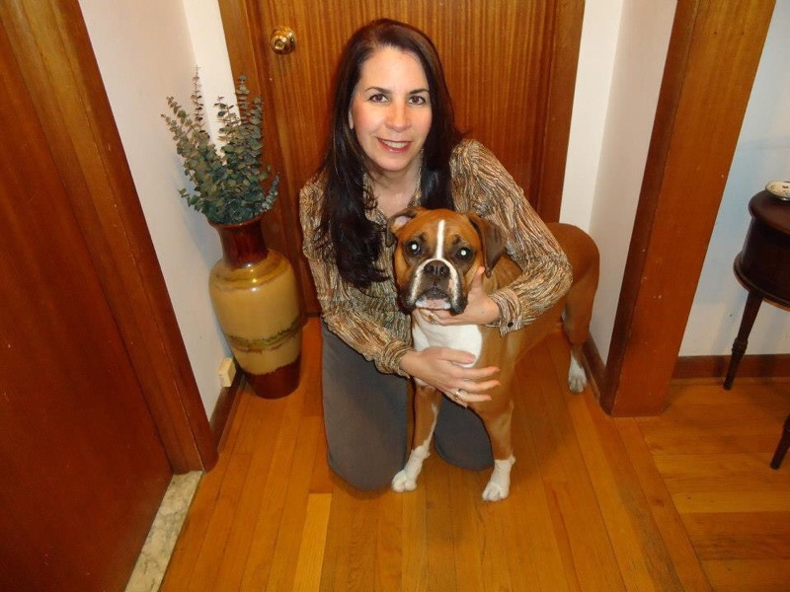
Tania Thomas, Amanda Thomas' Mom

Slide 30
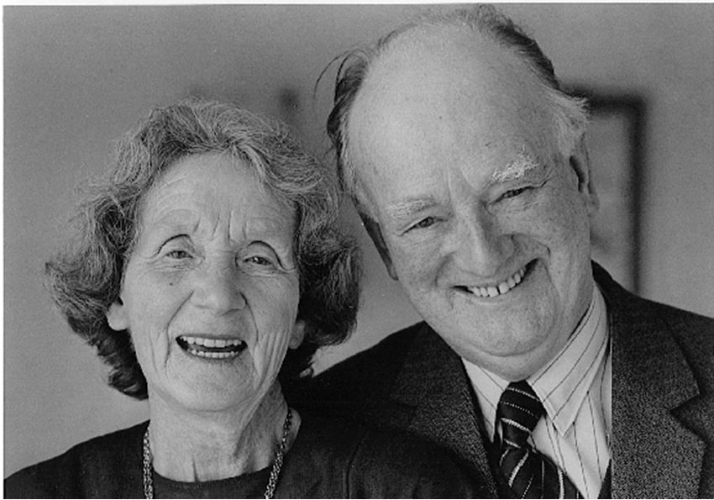
Elsie Valentine, Georgina Holdsworth’s Mother

Slide 31
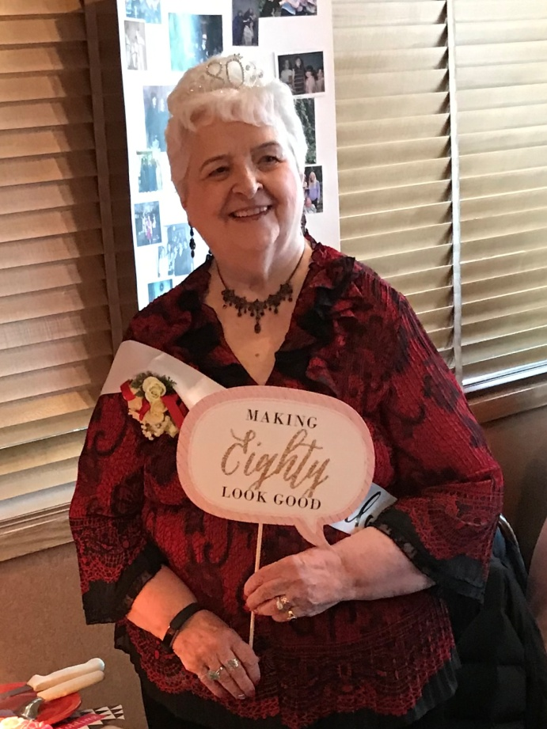
Carol Watson, Jill Gillis' mom

Slide 32
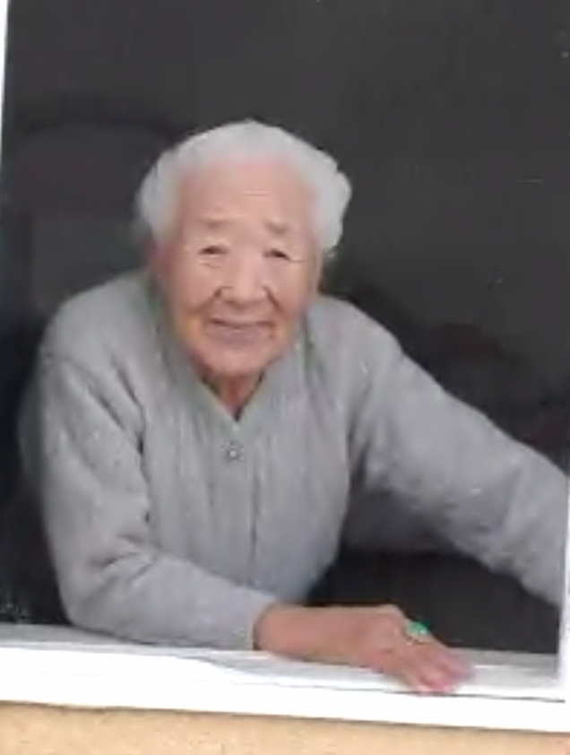
Soon Ae Yoo, Pastor Cho's Mother

