Slide 1
Pets of Fairfield Grace

Slide 2
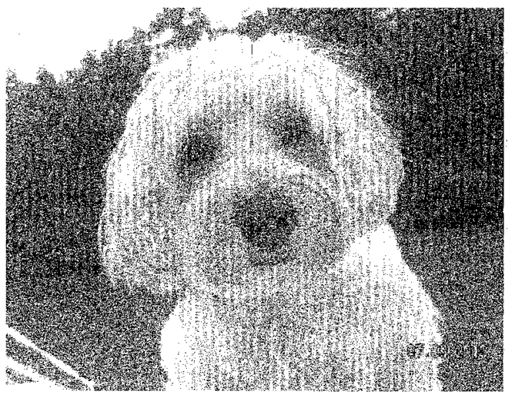
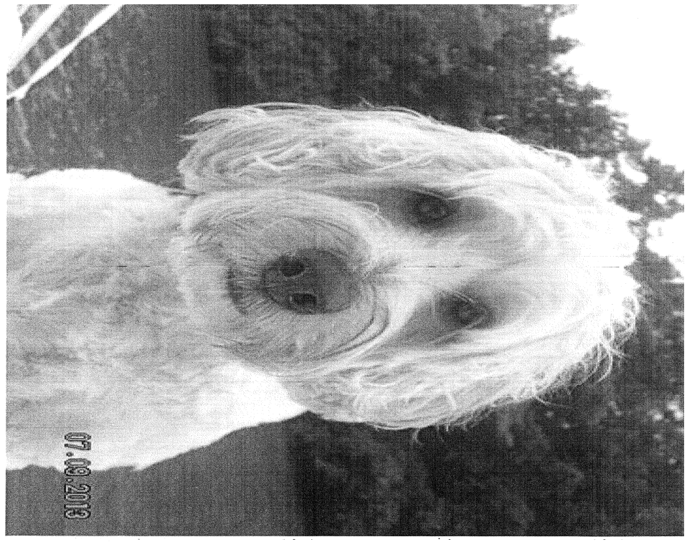
Lucy, Karen Benson’s family pet

Slide 3
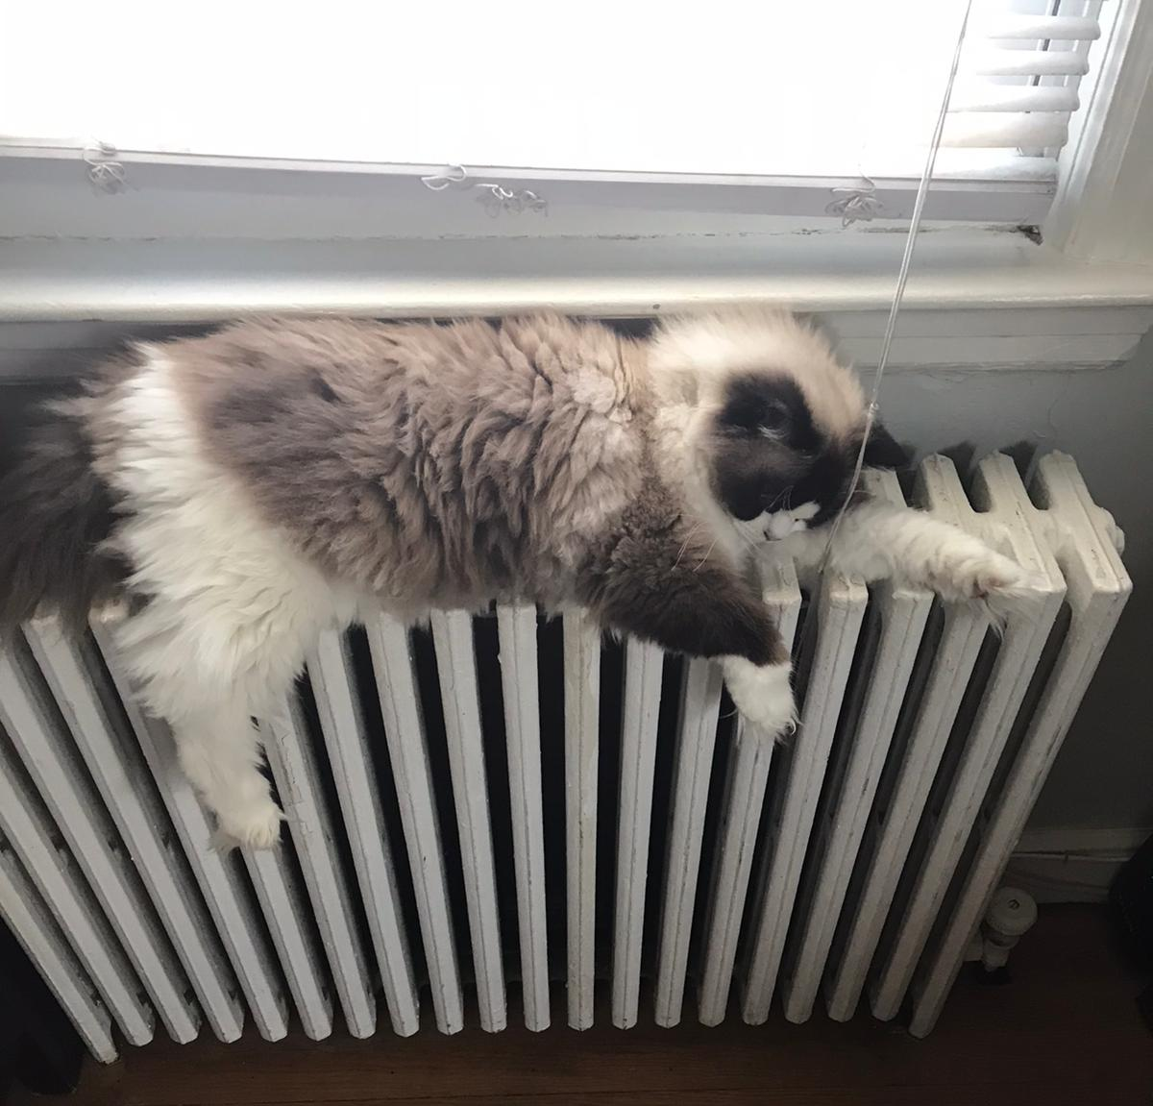
Daphne, Sandra Brown’s pet

Slide 4
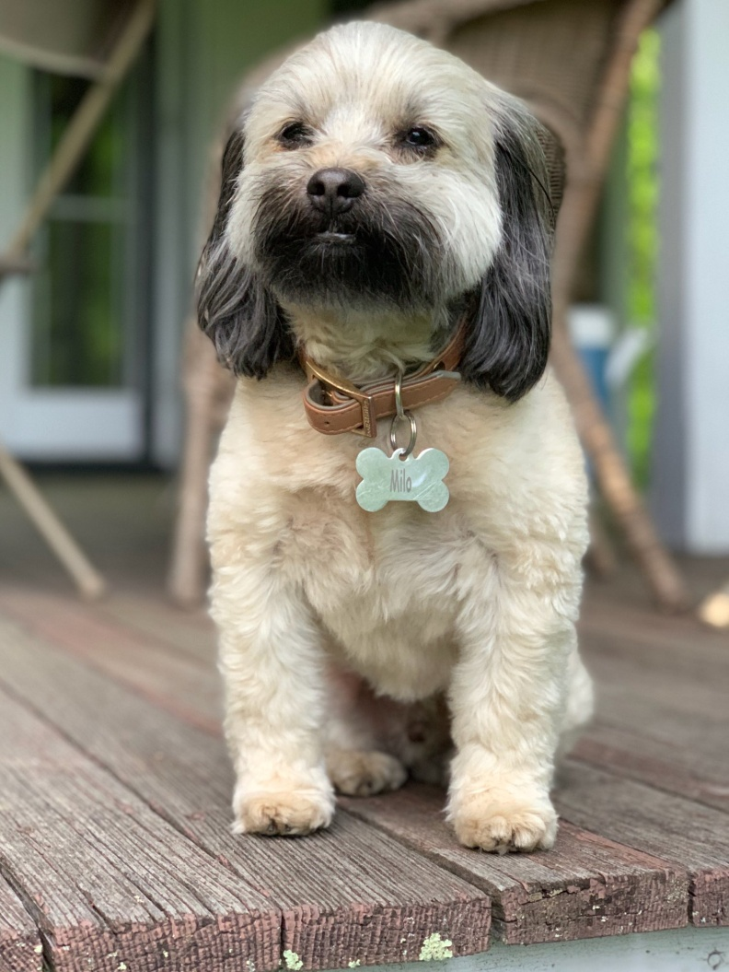
Milo, Nancy Chavez’ pet

Slide 5
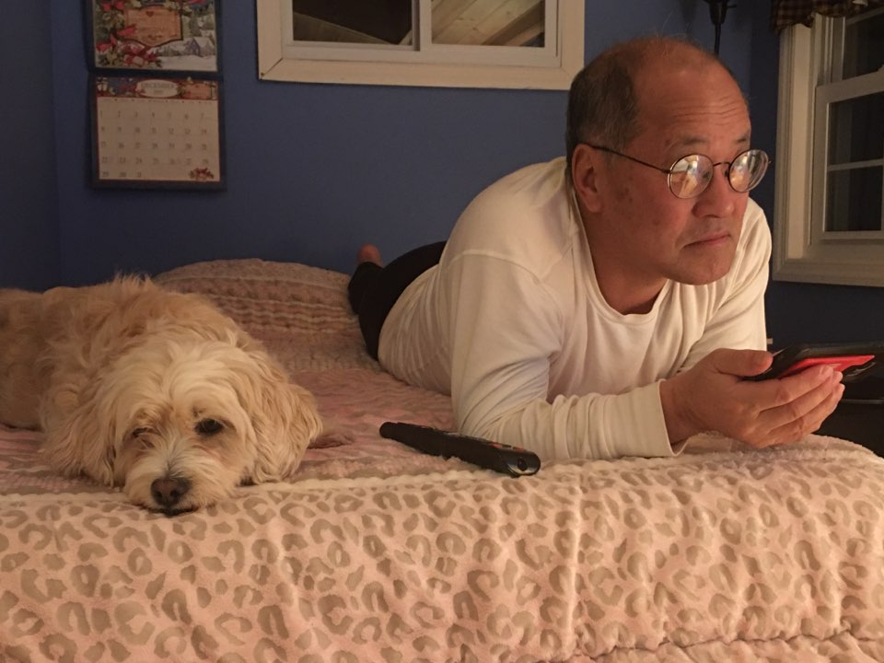
Minnie and Pastor Cho

Slide 6
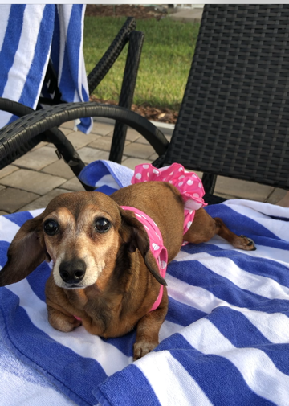
Rosie, Maggie Conroy’s pet

Slide 7
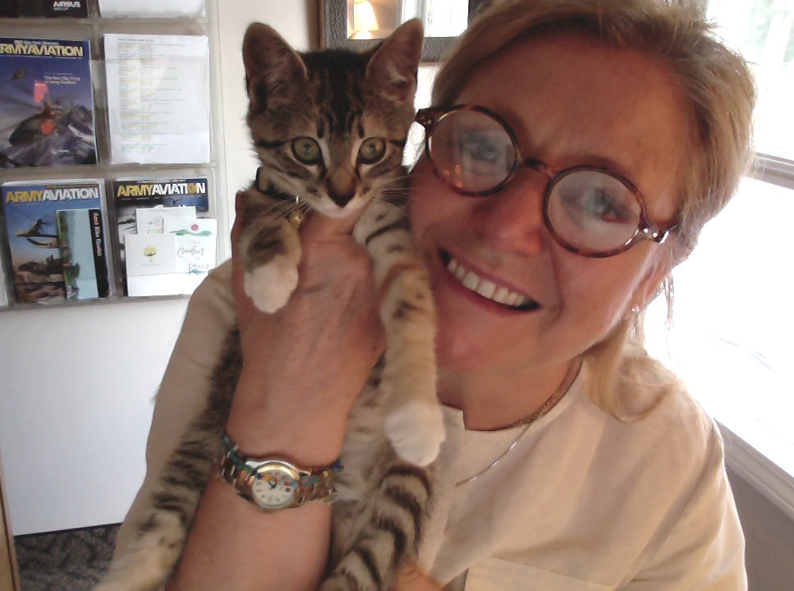
Lily, Anne Ewing’s pet

Slide 8
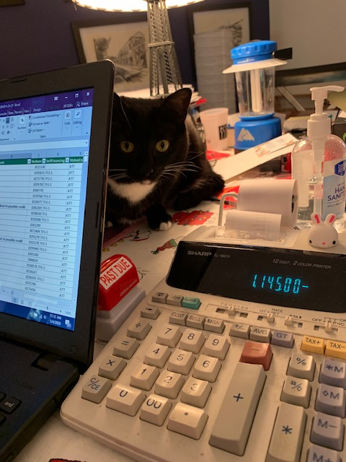
Ginny, Jill Gillis’ pet

Slide 9
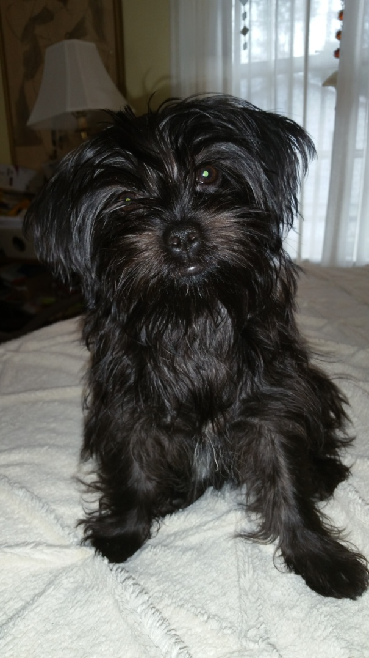
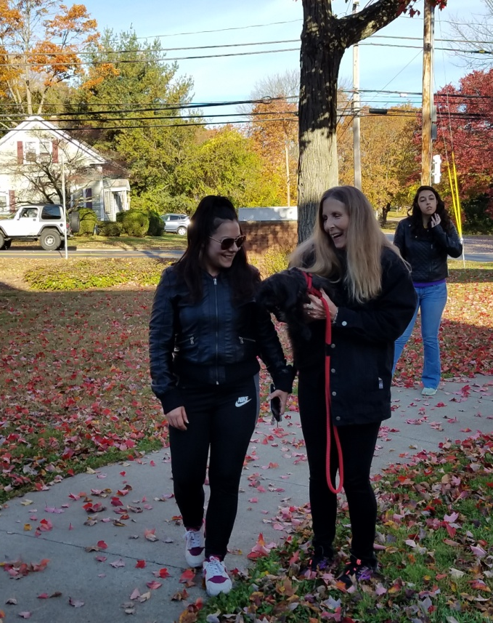
Amaya, Kristina Joukhadar’s pet

Slide 10
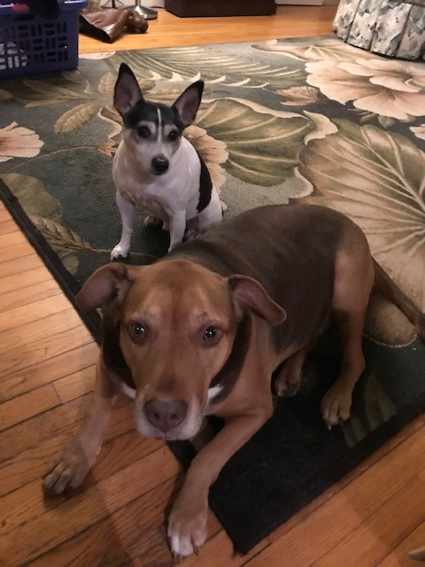
Barre and Russell, Jugielewicz’ family pets

Slide 11
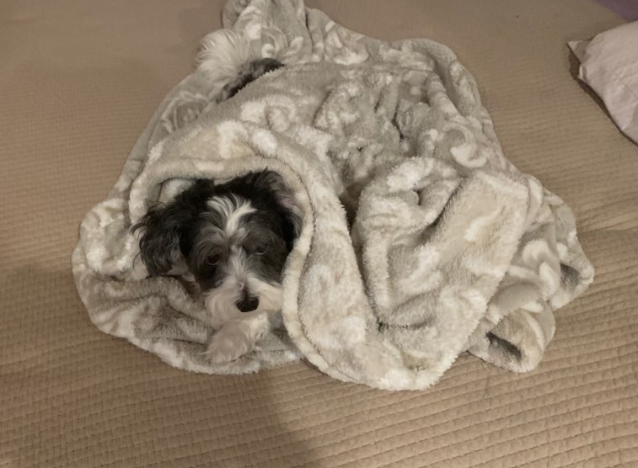
Hogi, Rev. Jong Sung Kim’s pet

Slide 12
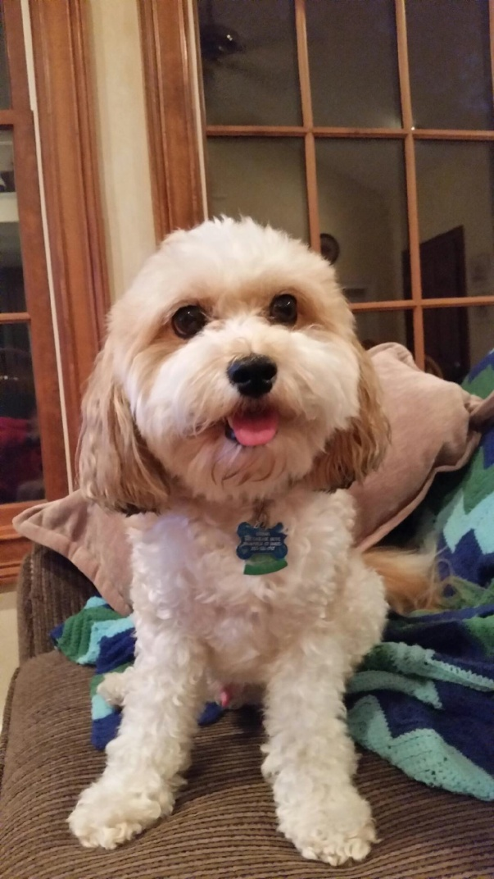
Cosmo, Leppla family pet

Slide 13
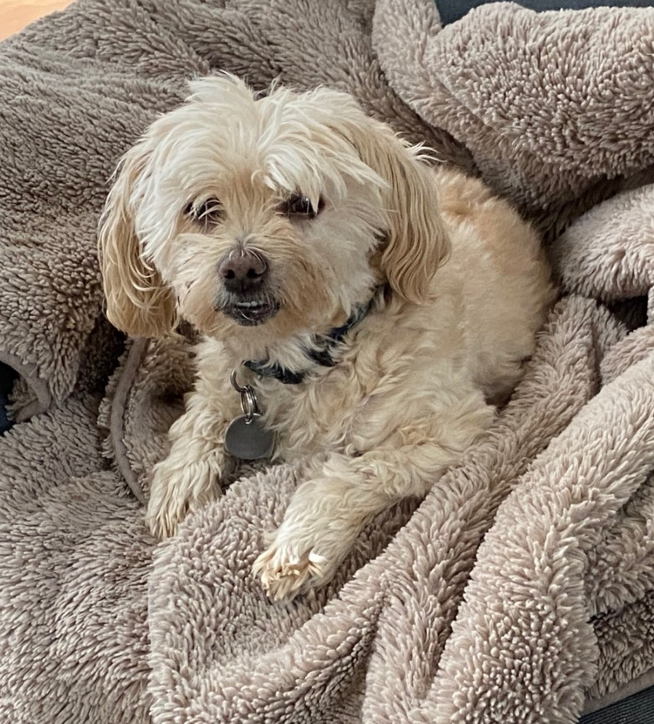
Duke, Regan family pet

Slide 14
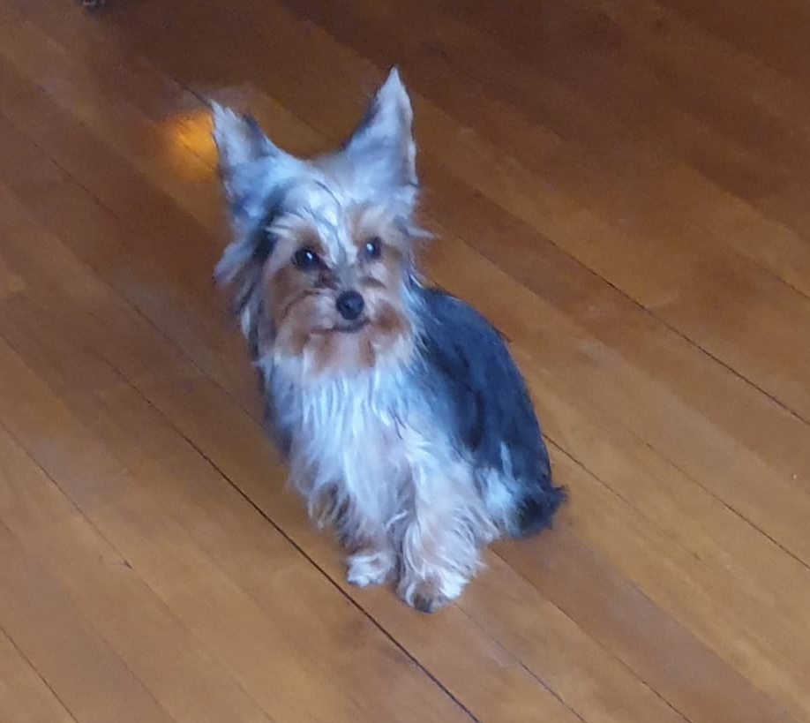
Benny, Miguel Restrepo’s pet

Slide 15
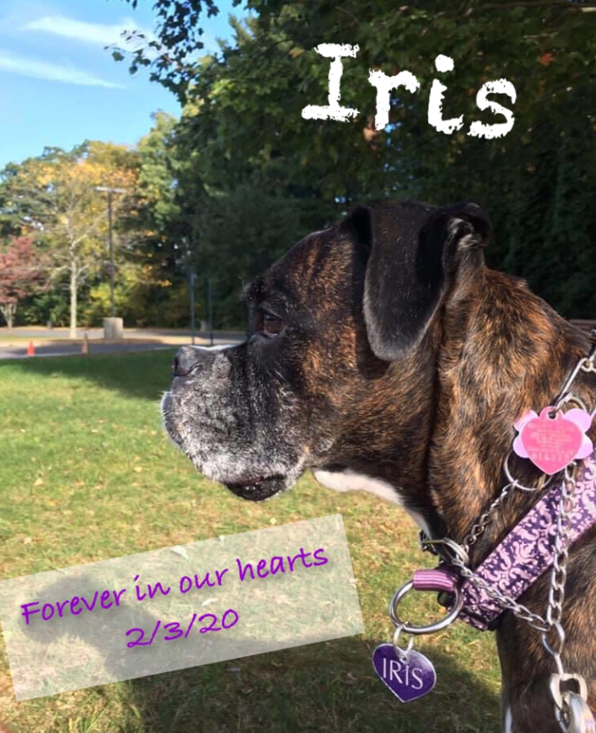
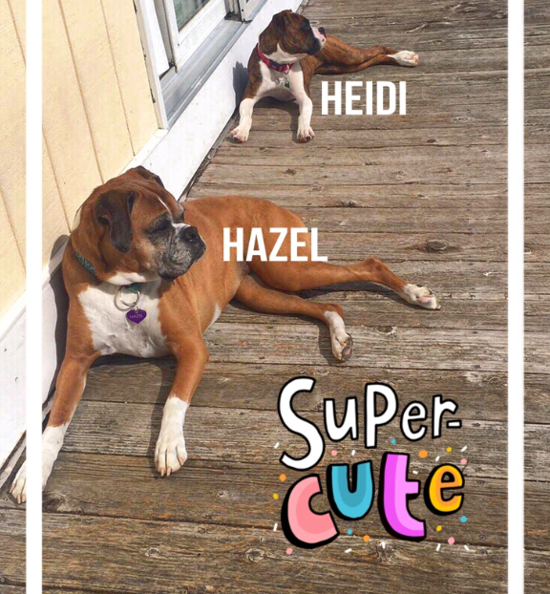
Hazel and Heidi, Amanda Thomas’ pets (and Iris, passed)

